Slide 1

Restaurants
Sunny Bibyan
Feb 2025

Slide 2
Problem Statement
Zomato wants to analyse the places in which they can set up its new restaurants.
For this, we have addressed missing values in Cuisines section to enhance data integrity.
This dataset allows for an in-depth understanding of Zomato’s market presence and operational scope.
Insights from user demographics and order volumes are key to optimizing marketing strategies and expanding product offerings.
Hence, in further slides we will draw conclusions from the data analysis and identify potential areas for Zomato to understand the Market.

Slide 3

Data Overview
Total Restaurants count is 9551.
Average Rating of all the restaurants across the world is 2.89.
Average Cost for Two is $10.06 (combined currencies of different countries and converted them to common currency USD).
Total Votes are 14,98,645.
Services are provided in 15 Countries and 141 Cities worldwide.
Various Cuisines are served across regions.
This dataset provides comprehensive insights into restaurant performance and customer behavior across various countries.

Slide 4

Methodology
APPROACH AND TOOLS:
Data Cleaning: Used clean and remove duplicates function to get the cleaned data.
Data Enrichment: Used VLOOKUP function to get country name from country code , COUNTIF function to get count of restaurants, use of text to columns, Logical operators and aggregation functions to get average rating for all restaurants.
Descriptive Analysis: Use of pivot tables to create a dashboard for better understanding and summarize the data across cities and states all over the world.
Visualization: Created a dynamic dashboard showing various scenarios that help us for better understandment.

Slide 5

Analytical Approach

Slide 6
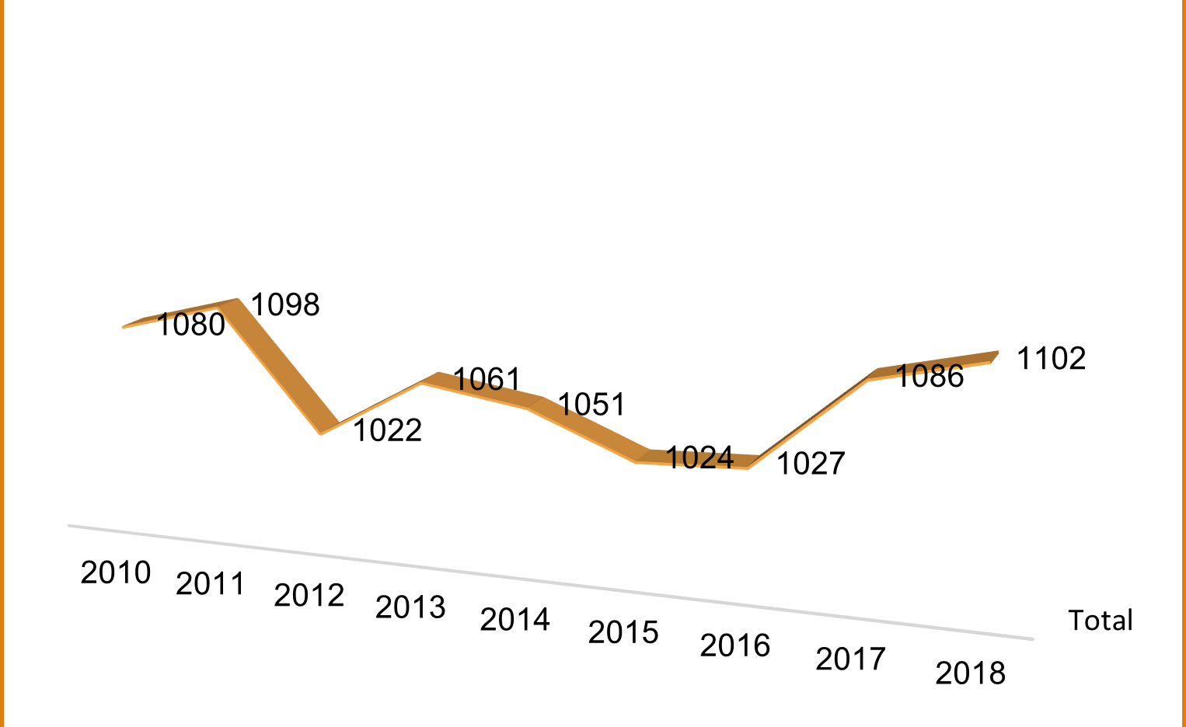
Year-Wise opening of Restaurants
Insights:
The data shows a consistent growth pattern, with a slight dip in 2012 and a small increase in 2017.
The number of restaurants has been steadily increasing over the years, with a peak in 2018.
This trend suggests that there is a growing demand for restaurants in the market.
Recommendations:
Monitor market trends: Continuously monitor market trends and consumer preferences to stay ahead of the competition and adapt to changing consumer behaviors.
Focus on customer experience: Focus on improving customer experience by enhancing menu offerings, services, and overall dining experience.
Enhance operational efficiency: Focus on improving operational efficiency by streamlining processes, reducing waste, and optimizing resources.

Slide 7
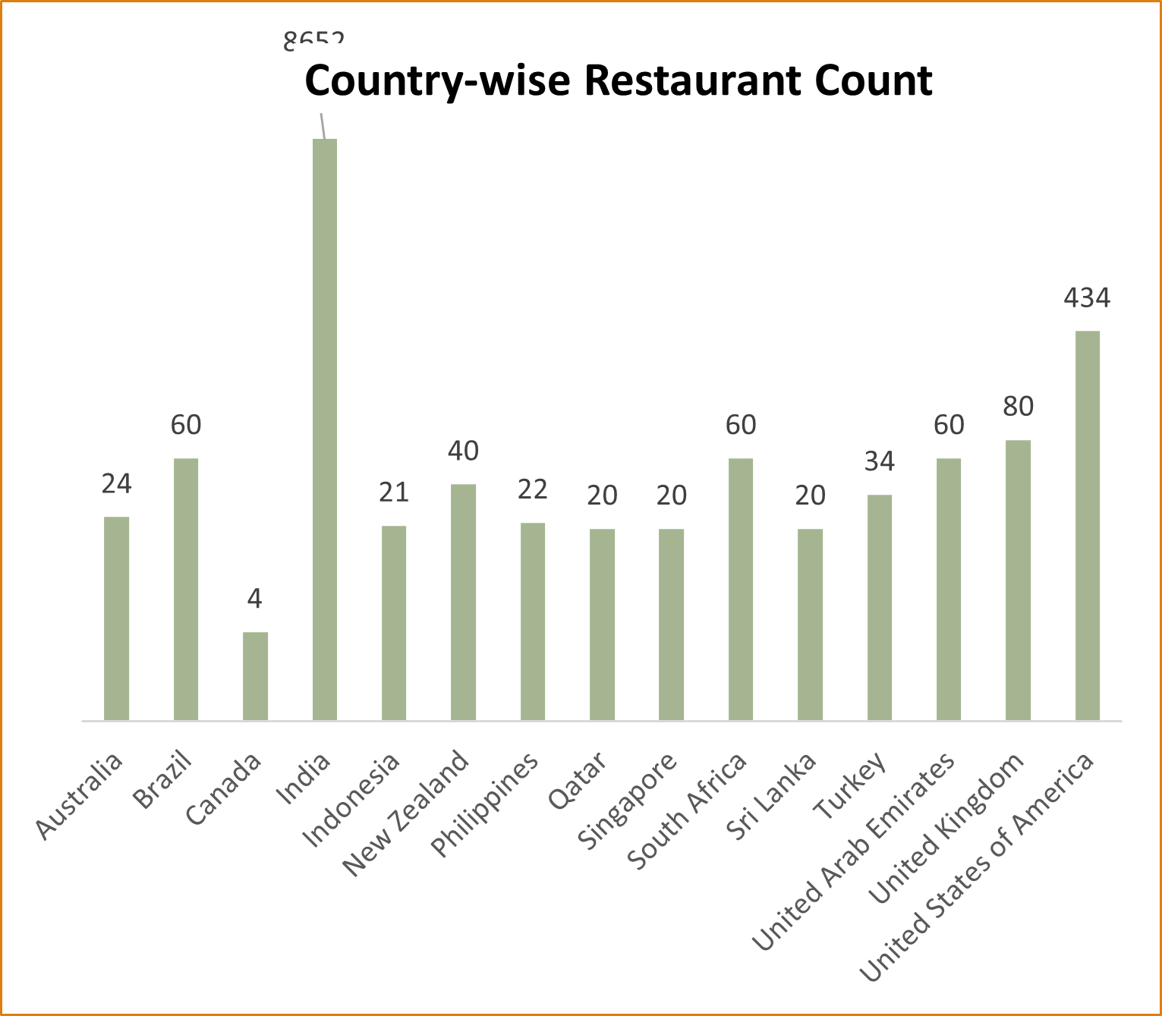
Global Distribution of Restaurants
Insights:
Asia dominates: The data shows that most of the countries are from Asia, with India having the highest number of restaurants (8652).
Global presence: The data indicates that restaurants are present in various countries across the globe, including Australia, Canada, New Zealand, and the United Kingdom.
Middle East presence: The data shows that there are restaurants in the Middle East, specifically in Qatar, United Arab Emirates, and Turkey.
Recommendations:
Target emerging markets: Consider expanding to emerging markets in Asia, such as Indonesia, Philippines, and Sri Lanka, which have a relatively low number of restaurants.
Focus on high-demand markets: Countries like India, United States of America, and United Kingdom have a high number of restaurants. Focus on these markets to increase brand visibility and customer base.
Diversify globally: Continue to expand globally, exploring new markets in Latin America, Europe, and other regions.
Localize offerings: To cater to diverse consumer preferences, consider localizing menu offerings and services to appeal to local tastes and cultures.

Slide 8
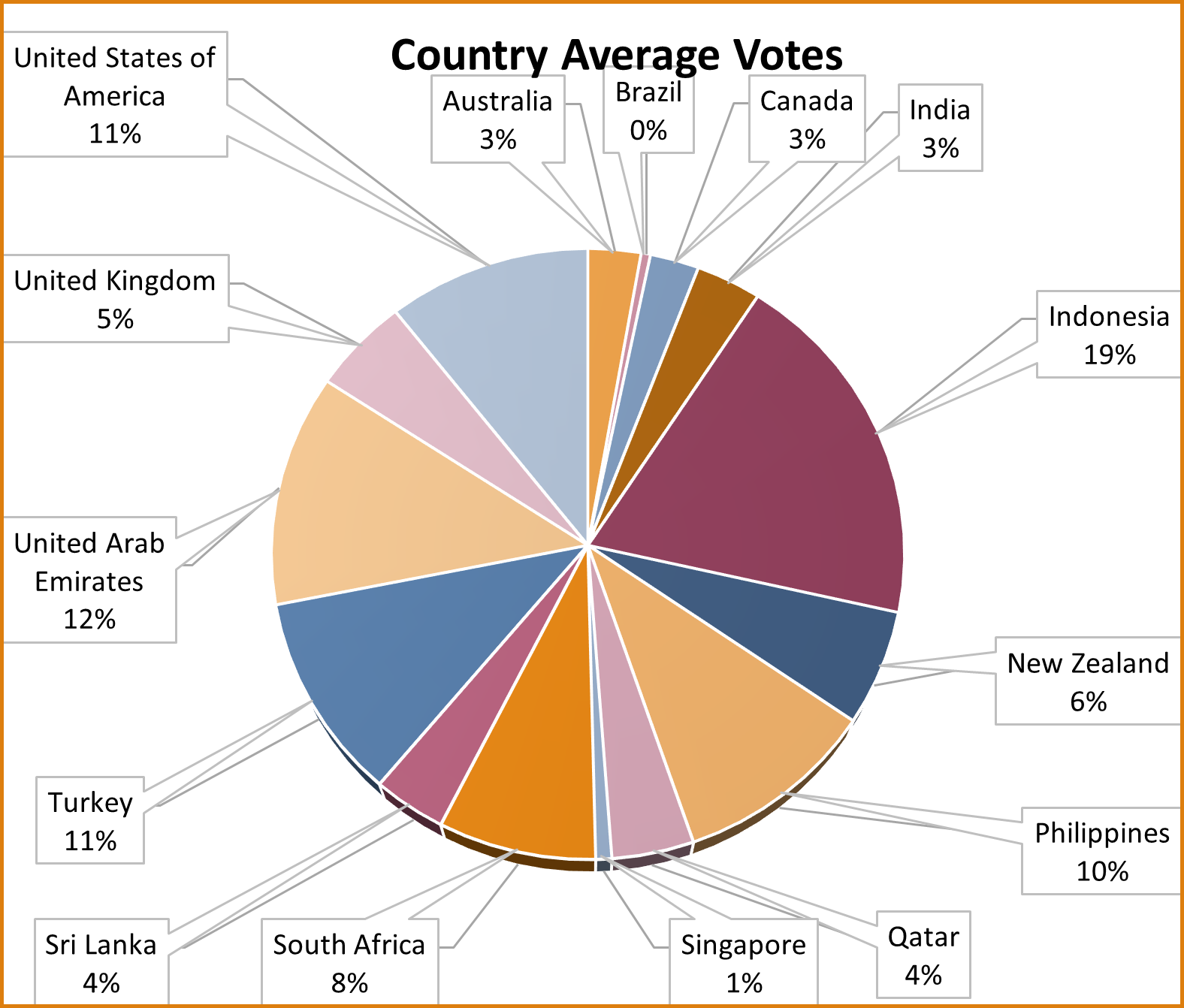
Average of Votes: A Comparative Analysis
Insights:
Indonesia, United Arab Emirates, USA, Turkey and Philippines have high average votes, indicating a strong demand for restaurants in these countries.
Consider opening restaurants in these countries to capitalize on the existing demand.
Remaining countries have low average votes, indicating a lower demand for restaurants.
Recommendations:
As high average votes, we can consider opening high-end restaurants that cater to the affluent population.
Focus on catering to local tastes and preferences, incorporating traditional flavors and ingredients into your menu.
Invest in quality food and service: Invest in high-quality ingredients, cooking techniques, and exceptional service to maintain customer satisfaction.

Slide 9
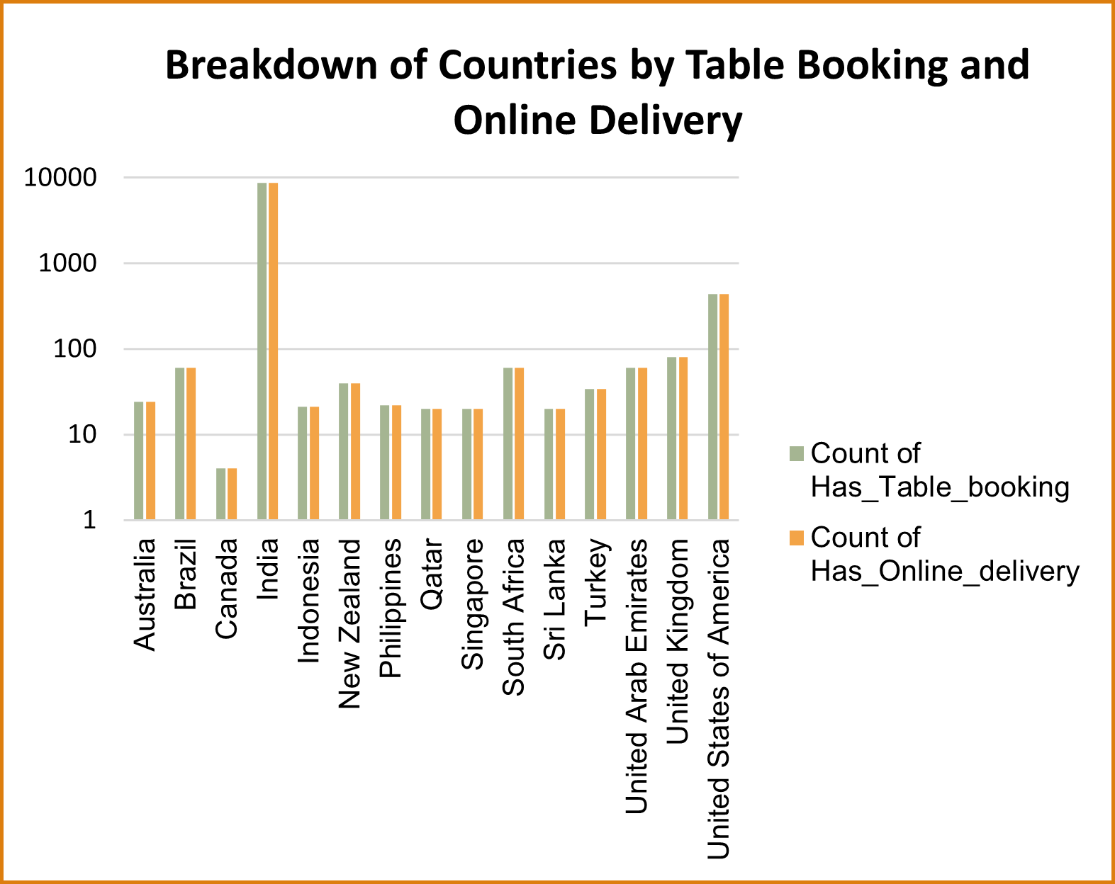
Global Restaurant Landscape: Table Booking and Online Delivery
Insights:
With over 8652 restaurants offering both amenities, India has the largest number of restaurants with these options. This is likely due to its large population and growing demand for convenience.
With over 434 restaurants offering both amenities, the US has a significant number of restaurants with these options, particularly in urban areas.
With over 60 restaurants offering both amenities, Brazil has a smaller but still significant number of restaurants with these options, particularly in cities like Rio de Janeiro and São Paulo.
Recommendations:
Invest in online delivery infrastructure to reach new customers and increase revenue.
Develop targeted marketing campaigns to promote table booking and online delivery options to customers who may not be aware of them.
Consider expanding into new markets where online delivery and table booking options are not yet widely available.

Slide 10
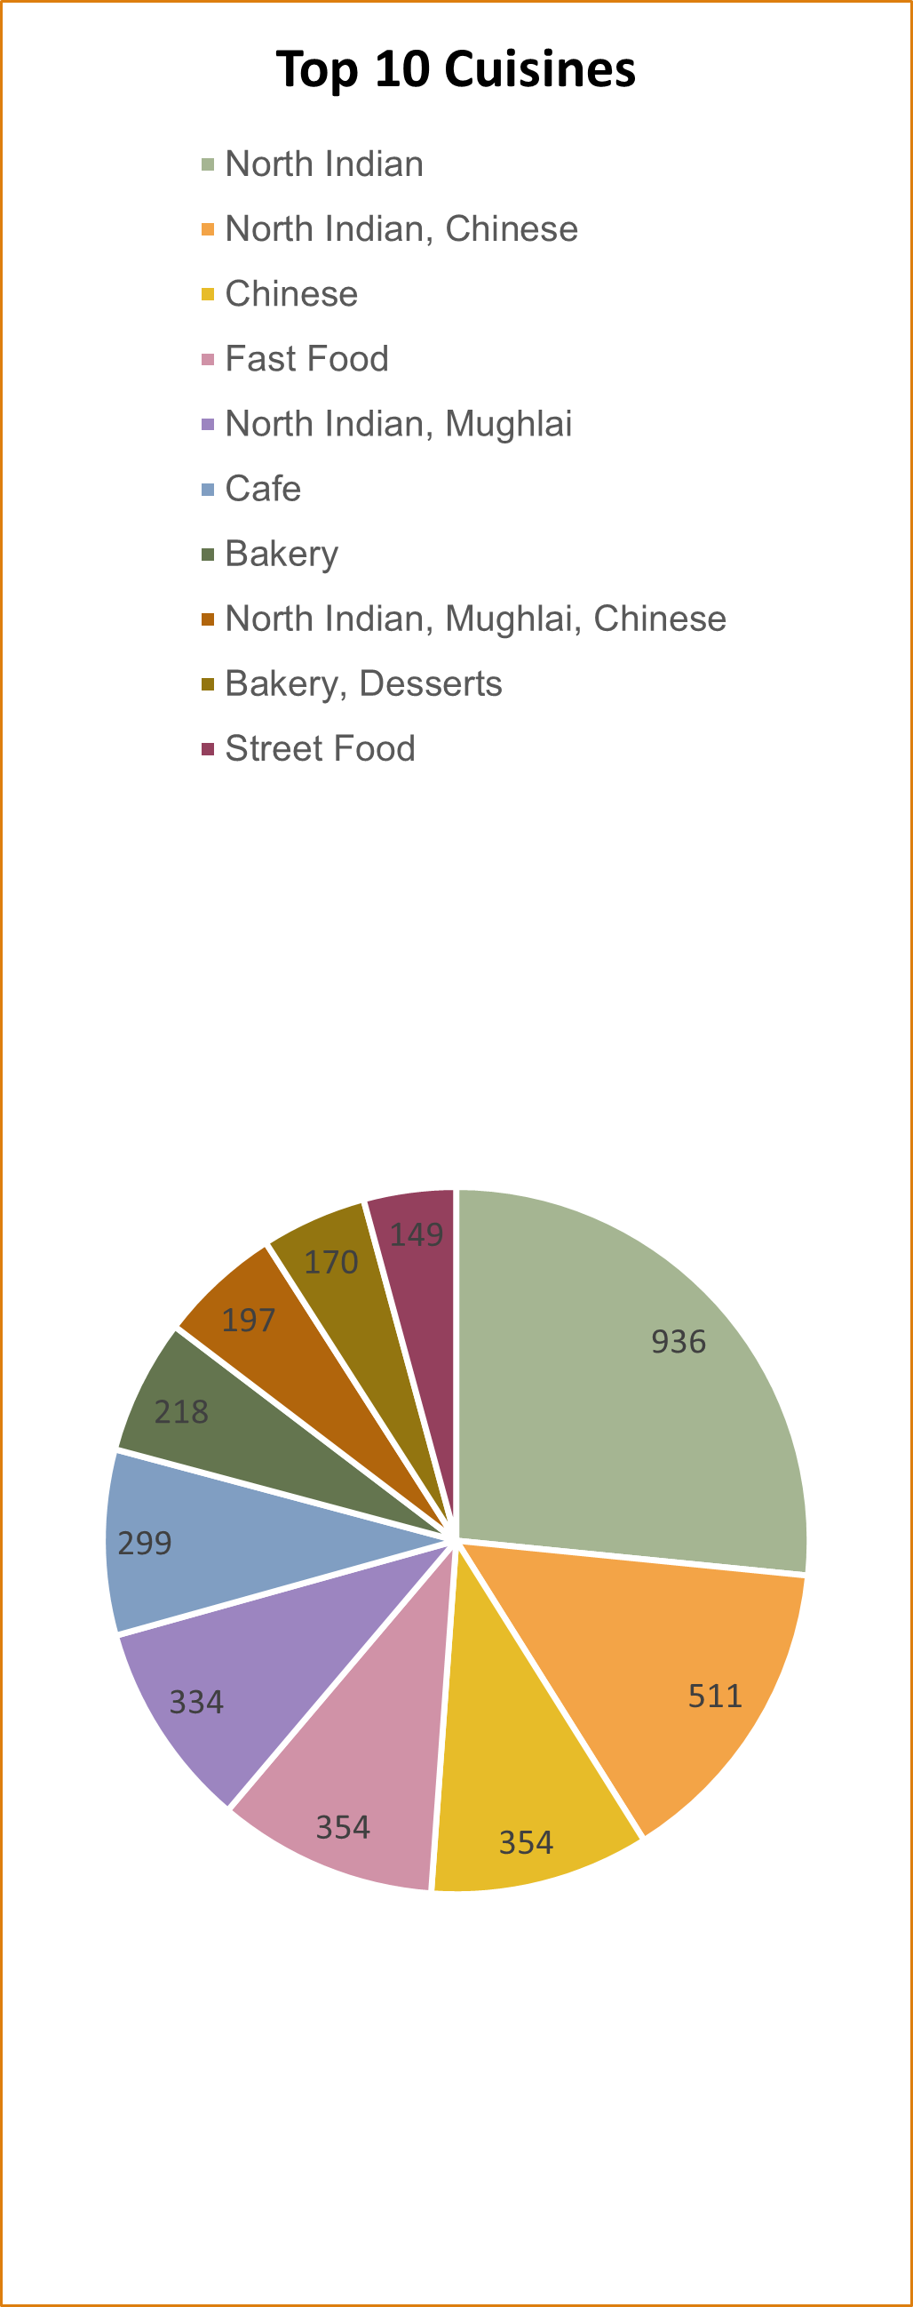
Top 10 Restaurant Cuisines
Insights:
North Indian: High demand for traditional dishes like biryani and tandoori chicken.
Chinese: Growing popularity of fusion cuisine and take-out options.
Fast Food: High demand for quick and affordable meals.
North Indian, Mughlai: Blend of traditional and modern flavors.
Cafe: Focus on specialty coffee and baked goods.
Recommendations:
Restaurants should consider offering a mix of traditional and modern dishes to cater to diverse tastes.
Traditional cuisines like North Indian and Chinese are still in high demand and Fast Food chains are adapting to changing consumer preferences.
Invest in marketing and advertising campaigns to promote specific cuisines.

Slide 11
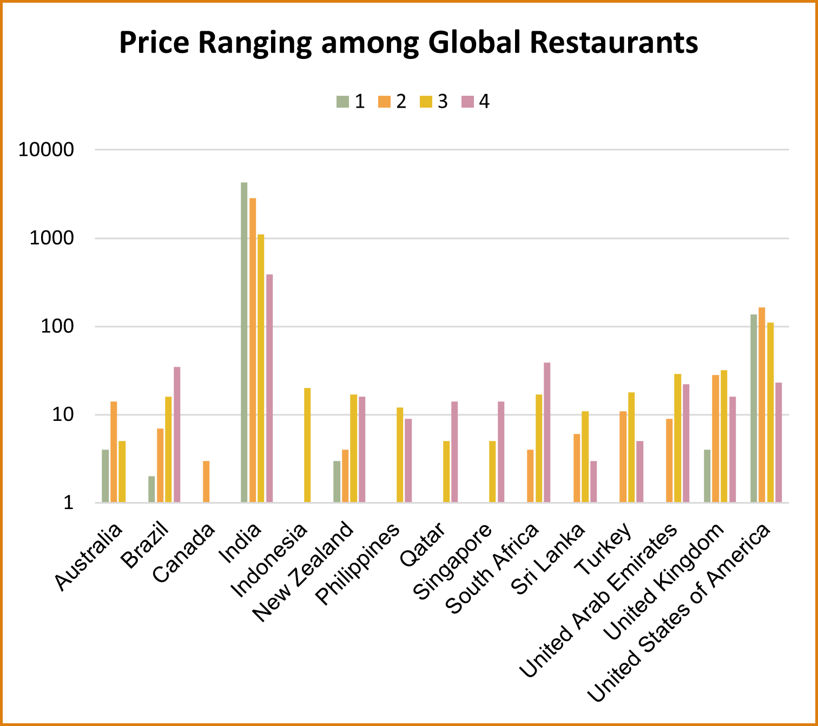
Restaurant Price Range Distribution Globally
Insights:
With over 8,500 restaurants, India is far ahead of the other countries in terms of the number of restaurants. This could be due to its large population and diverse culinary landscape.
Countries like Indonesia, Philippines, Singapore, and Turkey are also well-represented on the list, indicating a strong presence of restaurants in the Asia-Pacific region.
The data suggests that there is a diverse range of restaurant types represented, including fast food, casual dining, and fine dining options.
Recommendations:
Countries like India, Indonesia, and the Philippines are growing rapidly, and there may be opportunities to expand into these markets.
With the diverse range of restaurant types represented, it may be beneficial to focus on diversifying menu offerings to cater to a wider range of tastes and preferences.
With the increasing popularity of online ordering and delivery, investing in technology and digital platforms may be essential to stay competitive in the market.

Slide 12
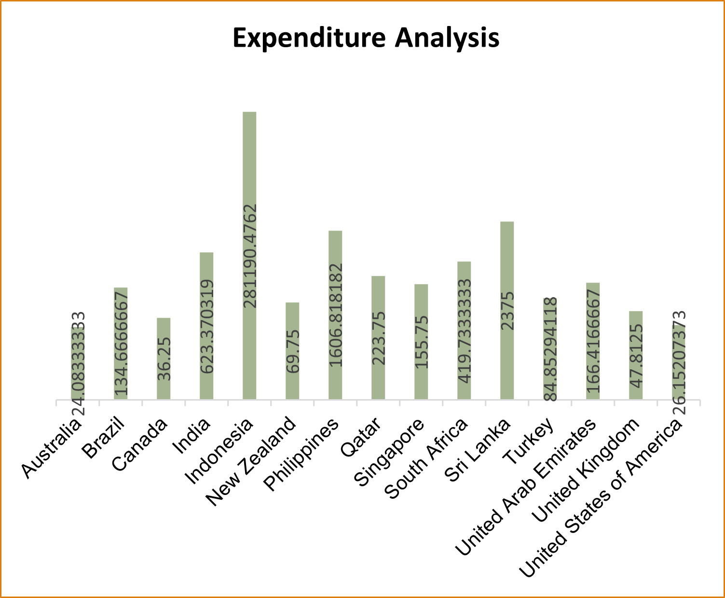
Pricing Insights: A Global Restaurant Analysis
Insights:
Countries like India, Indonesia, Philippines, and Singapore have a high average cost for two, indicating that they may have more expensive dining options compared to other regions.
Countries like Canada, United Kingdom, and United States of America have a relatively low average cost for two, indicating that they may have more affordable dining options compared to other regions.
Recommendations:
Target high-end diners in India and Indonesia as it may be beneficial who are willing to spend more on dining experiences.
To cater to a wider range of customers in Asia-Pacific, we can include menu offerings and more affordable options or promotions that appeal to a broader audience.
Focus on sustainability and environmental friendliness to appeal to customers who are concerned about these issues.

Slide 13
Strategic Recommendations
From each recommendation given we can understand the below points to set up new restaurants .
Analyzing Trends in different countries with existing restaurants: Different metrics such as providing Online delivery & Table booking, Ratings, Cost, Price range etc are used to analyse the locations where the new restaurants can be set up.
Identifying New markets: Target the locations that has no online delivery/ table booking, less ratings etc. So that the new ones can grab the opportunity to provide all the services that isn’t present already and attract more customers thereby gaining popularity with maximum ratings compared to the existing ones in the market.
Analyzing Cost Trends: Though from our analysis we understand that the cost of the cuisine doesn’t affect the rating. We can still try and keep the cost as nominal as possible suitable for all the levels of customers.

Slide 14
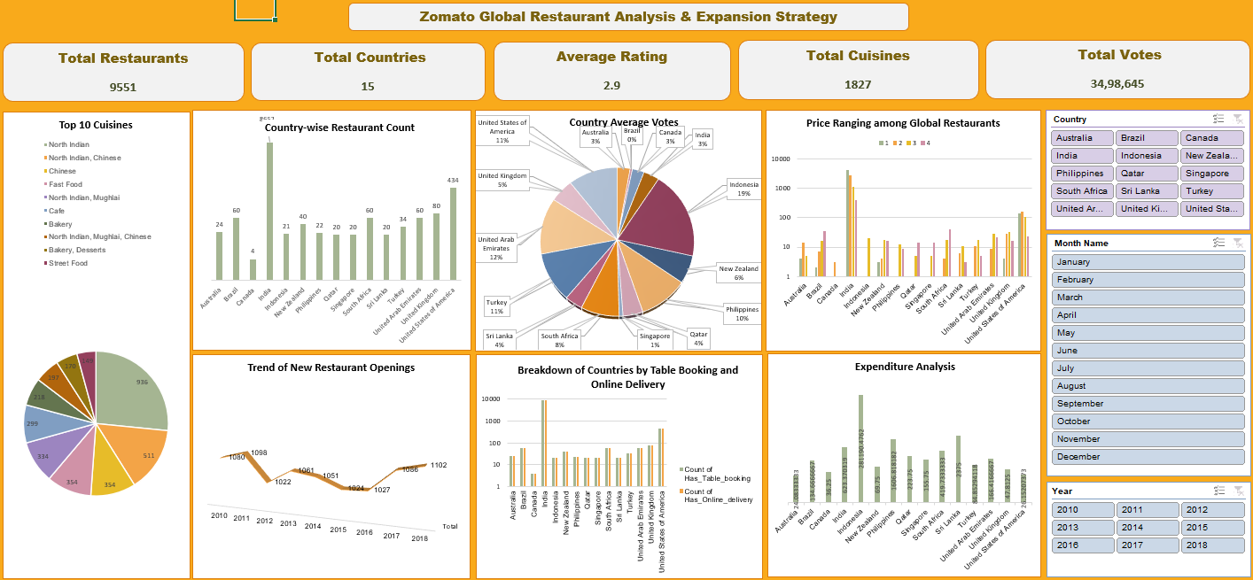
Dashboard

Slide 15

Conclusion
Popular Indian cuisine is North Indian owing to major North Indian cities and for the USA it’s all American food.
India and US have moderate food prices as compared to the rest of the countries.
We can check number of restaurants established year wise using interactive slicers.
Positive relation exists between ratings and the average cost for two, this could be because of the assumed notion that premium restaurants have good ambiance or better service, whereas regular restaurants cannot provide such an experience which could lead to lower ratings.
Provide reservations and online delivery to receive valuable customer feedback and rating.
Thank You

